Slide 1
Alphabet Project
By: Jaime Rodriguez, Kaelob Reinert, Selvin Rivera, Carlos Rivera, Jaime Miranda, Johnathan C. Alondra Vargas

Slide 2
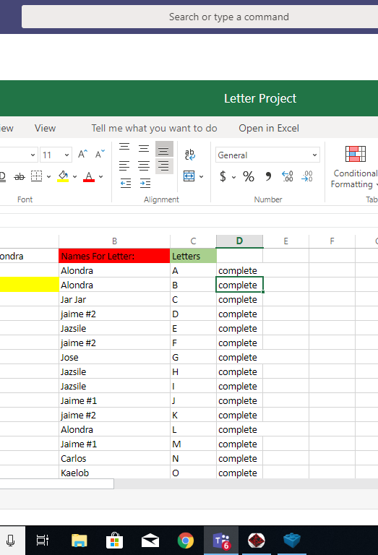
Letters Assigned
We used Excel and gave each other certain letters to complete. Once done we uploaded them into one file and marked them complete.

Slide 3
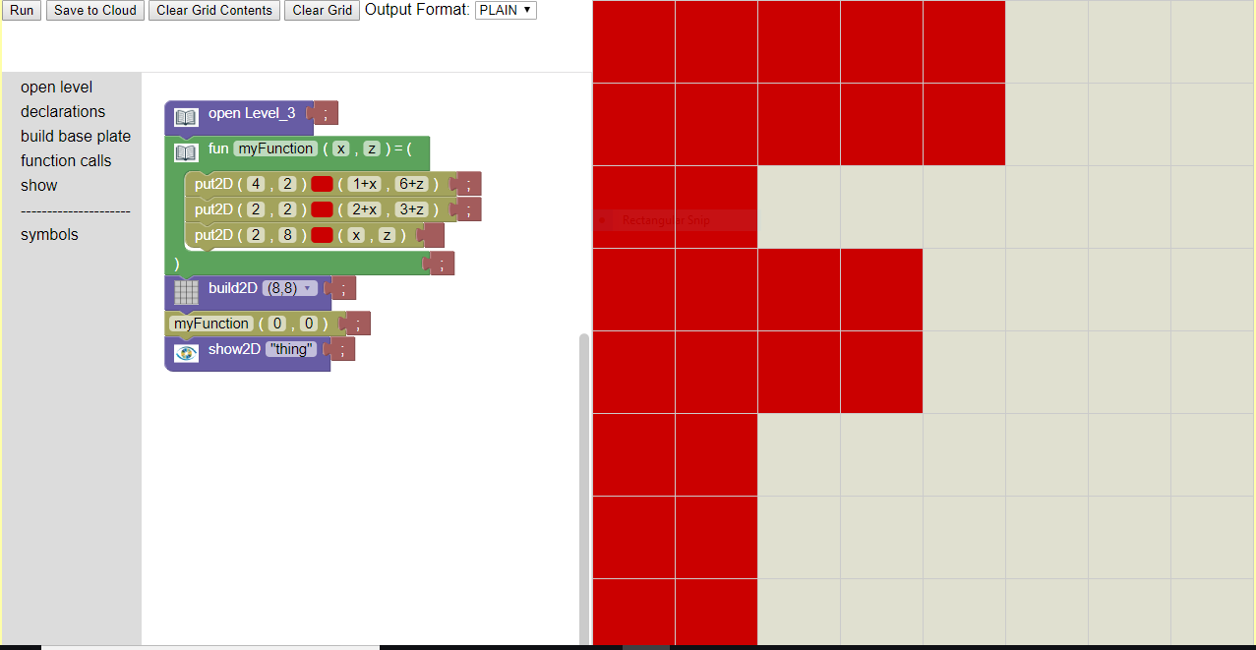
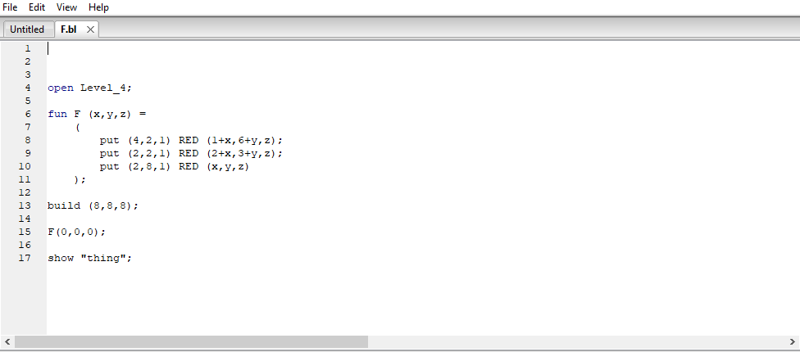
Process
We originally made our letters in Bricklayer-Lite
Then we transferred them to Bricklayer

Slide 4
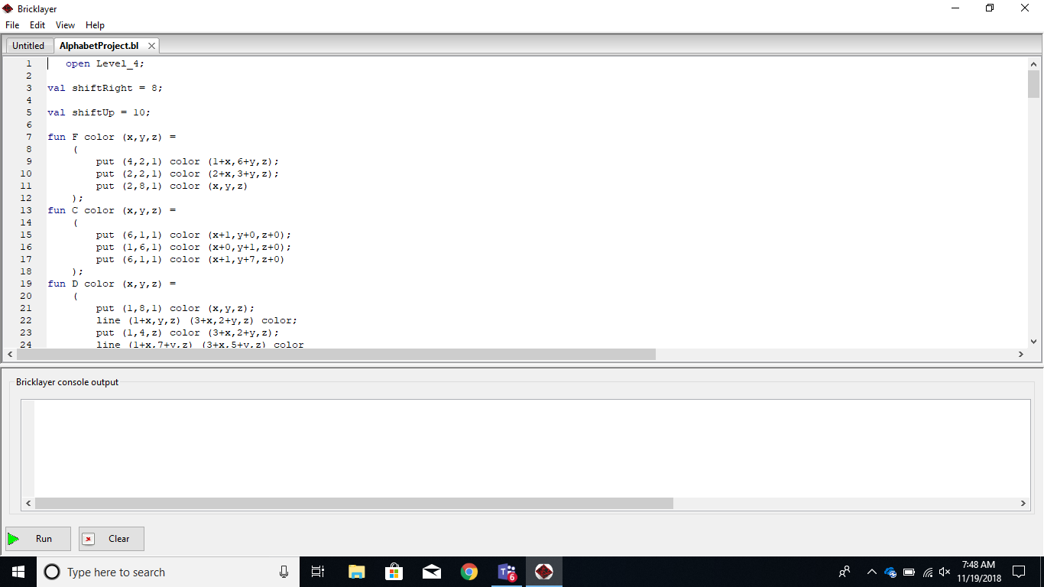
Our Code
While everyone worked on their letters, one person was on charge of taking the completed letters and putting them all into one bricklayer file and fixed any issues with the functions.

Slide 5
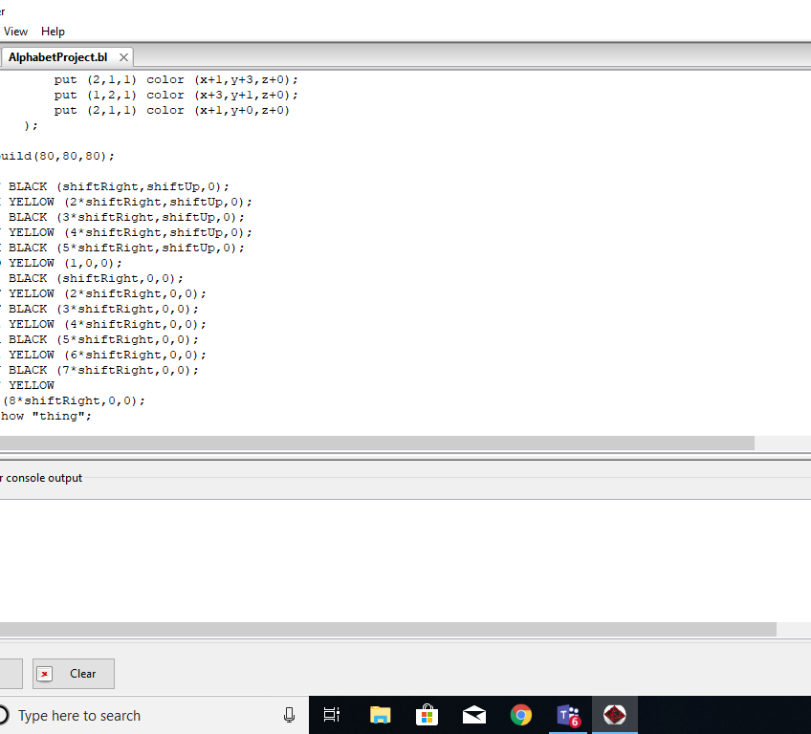
The End of the Code
We used functions to easily put our letter and color in so that it was all easy to modify.
We also turned our colors into variables so we could change them easily.

Slide 6
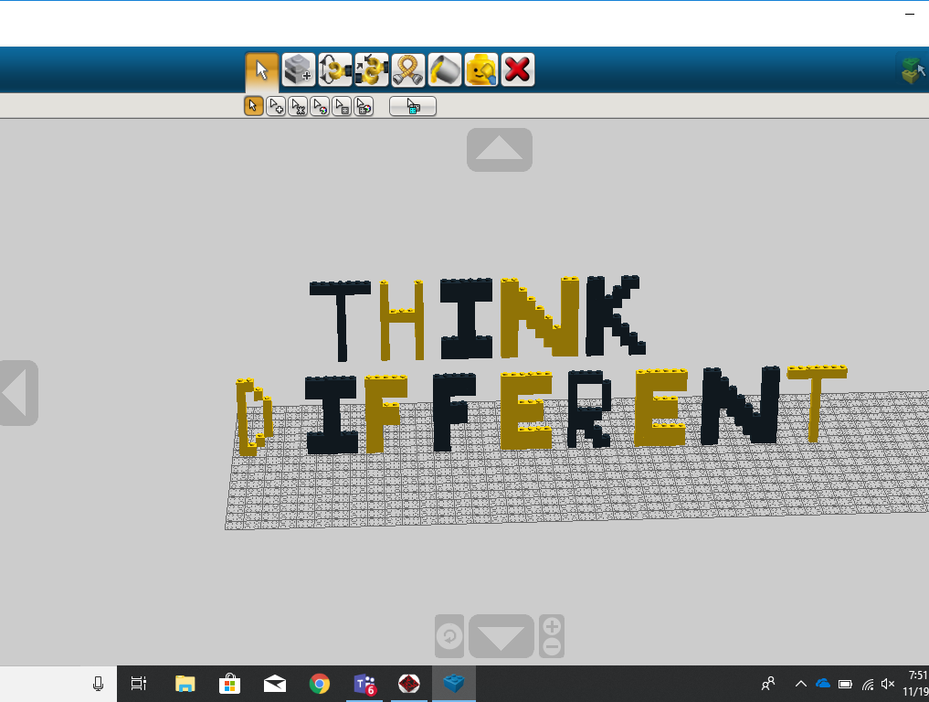
Some of our Quotes
"Think Different" (Apples Slogan). -Kaelob Reinert

Slide 7
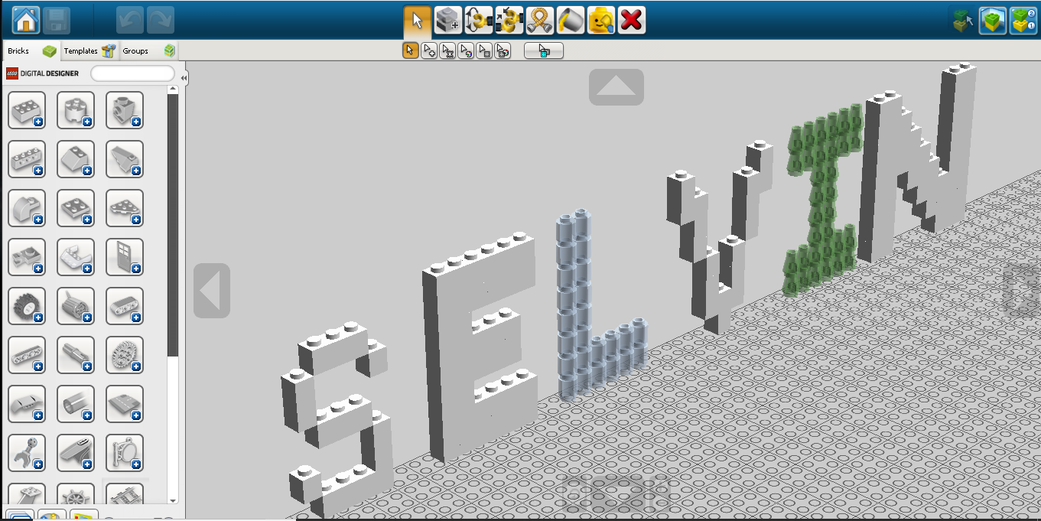

Slide 8
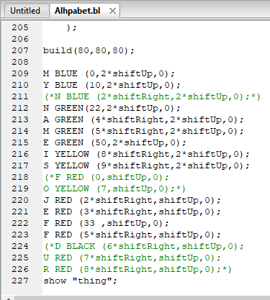
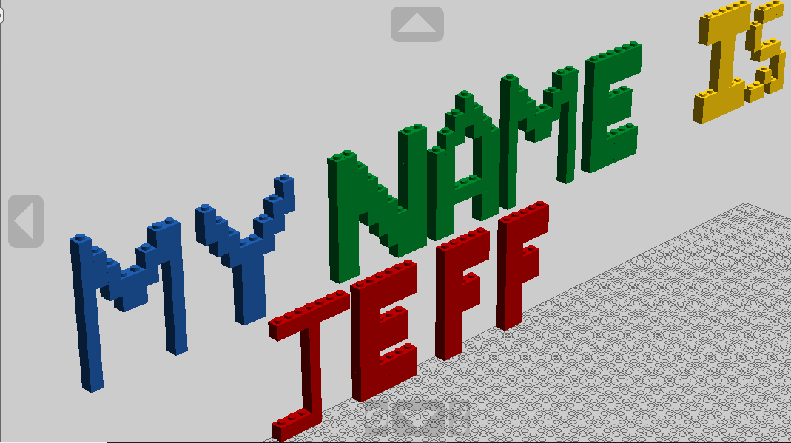
Quote by Jeff

Slide 9
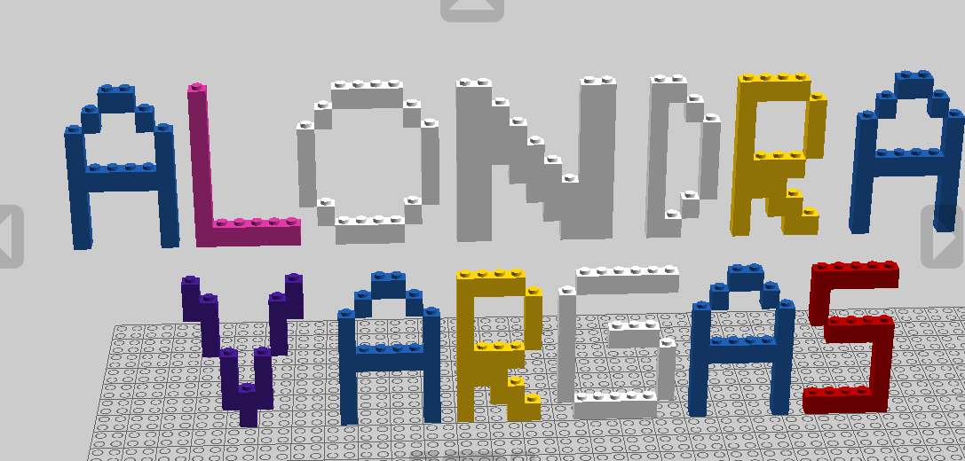

Slide 10
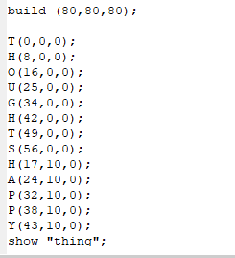
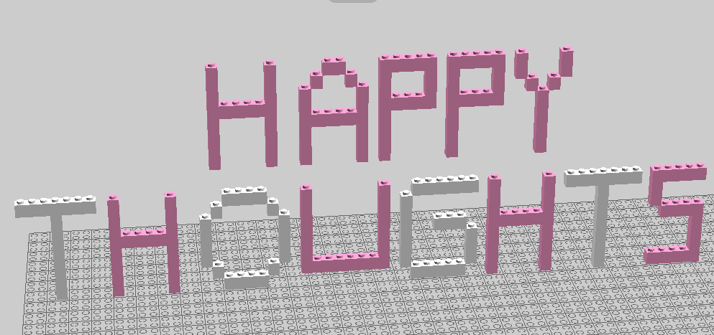
Alondra's Quote

Slide 11
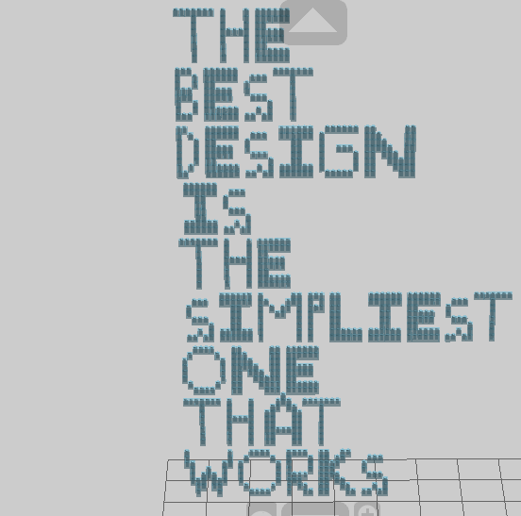
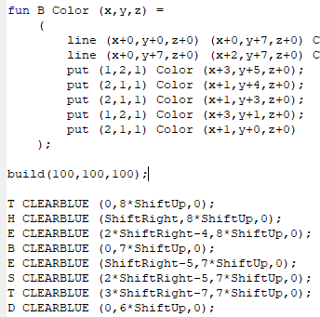

Slide 12
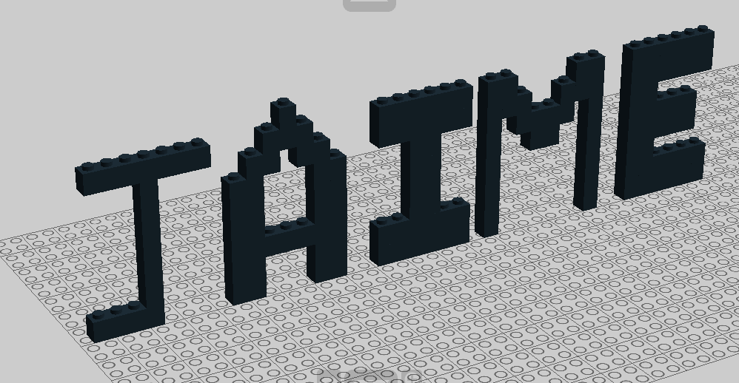

Slide 13
